Slide 1
Capstone Project: Rwanda Tourism Data Analysis
INTRO TO BIG DATA | Capstone Project 2025
Student: KAYIRANGA DEUS
ID: 26699
Lecturer: Eric Maniraguha

Slide 2
Project Introduction
Title: Rwanda Tourism Data Analysis Using Python and Power BI
Sector: Tourism & Environment
Goal: Analyze Rwanda’s international tourist arrivals and national park visit data to uncover insights and trends.

Slide 3
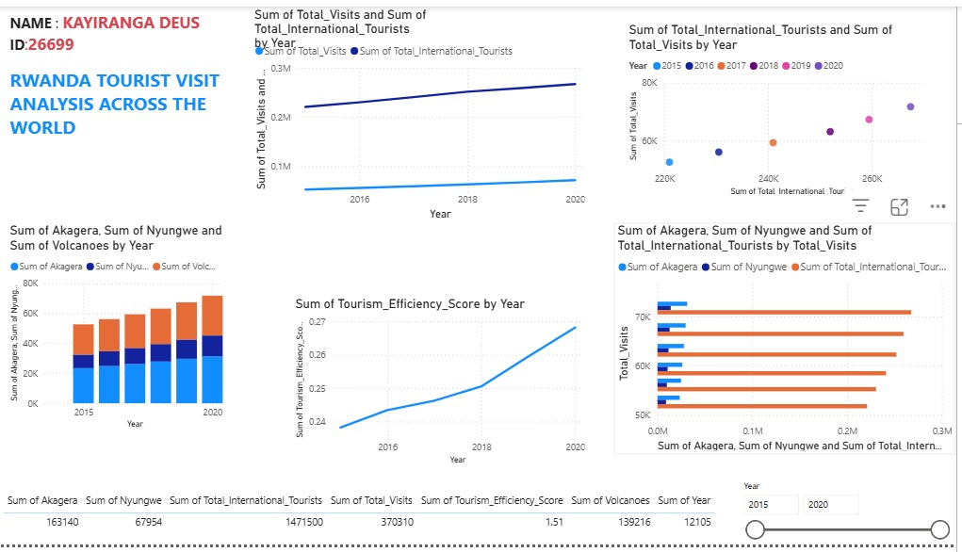
Problem Statement
Image Placeholder
Traditional tourism reports often fail to provide a clear view of which parks tourists engage with most, or how efficiently Rwanda converts tourist arrivals into park visits.
Can we use Python and Power BI to identify patterns, trends, and efficiencies in Rwanda’s tourism sector between 2015 and 2019?

Slide 4
Dataset Overview
Sources:
International Tourist Arrivals: Public data showing country-wise tourist counts per year
National Park Visits: Yearly visit counts for Volcanoes, Akagera, and Nyungwe Parks
Format: CSV (Structured)
Merged Dataset Columns: Year, Volcanoes, Akagera, Nyungwe, Total_Visits, Total_International_Tourists, Tourism_Efficiency_Score

Slide 5
Data Preprocessing & EDA
Cleaned column names and merged both datasets on the Year field
Grouped country-level tourist data to yearly totals
Engineered a custom metric: Tourism Efficiency Score (Total_Visits / International_Tourists)
Visualized trends and correlation (line charts, heatmaps, bar plots)
Area

Slide 6
Modeling with Regression & Custom Innovation
Regression Model: Used Linear Regression to predict Total Park Visits based on International Tourists
Random Forest: Applied ensemble learning for improved performance
Custom Innovation: Introduced Tourism Efficiency Score to measure engagement quality
Clustering: Used KMeans to group years based on visit patterns, evaluated using silhouette score
ick to add your content

Slide 7
Power BI Dashboard Overview
Line Chart: Trends in Tourist Arrivals and Park Visits (2015–2019)
Stacked Column Chart: Yearly visit breakdown by park
Bar Chart: Total visits by each park
Scatter Plot: Relationship between arrivals and park visits
Histogram: Distribution of Tourism Efficiency Scores
Cards: KPIs for total tourists, visits, average efficiency
Table: All merged data for reference
Slicer: Filter visuals by year

Slide 8
Key Insights
Tourist arrivals and park visits both grew steadily from 2015 to 2019
Volcanoes Park consistently had the highest number of visitors
Strong correlation between international tourist arrivals and park engagement
Efficiency score helped identify high-performance years

Slide 9
Recommendations & Future Work
Expand the dataset to include local tourism and revenue indicators
Forecast future visits using time series models (e.g., Prophet)
Deploy a live dashboard to support tourism ministry decisions
Segment tourists by origin to create targeted marketing strategies

Slide 10
Innovations
Custom Metric: Introduced the Tourism Efficiency Score to evaluate the proportion of tourists engaging with parks
Modeling: Used Random Forest regression and clustering with KMeans for deeper pattern discovery

Slide 11
Submission & Credits
GitHub Repository:
Tools Used: Python, Power BI
Bible Verse: Colossians 3:23 (NIV) - "Whatever you do, work at it with all your heart, as working for the Lord.“
Thank You!

